Slide 1
VISUAL ANALYSIS AND REPRESENTATIONS OF TYPE-2 FUZZY MEMBERSHIP FUNCTIONS
DESH RAJ
KENIL TANNA
BHUVNESH GARG
FRANK RHEE

Slide 2

Hello!
I am Desh Raj
I’ll be talking about data, fuzzy membership functions, applications and everything in between!
You can find me at:
r.desh26@gmail.com

Slide 3
1.
NEED FOR THIS RESEARCH
Let’s look at what inspired our research initiative

Slide 4
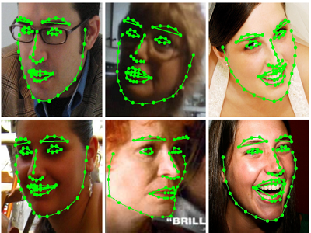

The numerous applications
Computer Vision
2D to 3D face modeling
RBF classification
FCM, Fuzzy ART
Natural Language Processing
Machines that write interesting novels in a specified style
Image source: Google

Slide 5


The numerous applications
Finance
Stock price analysis - Zarandi & Turksen
Computing with Words
Image source: Google

Slide 6
23,067
Number of Scopus results with the keywords “fuzzy set applications”

Slide 7
1,092
1,021
702
5,456
Mathematics
Chemical Engineering
Physics and Astronomy
Environmental Science

Slide 8
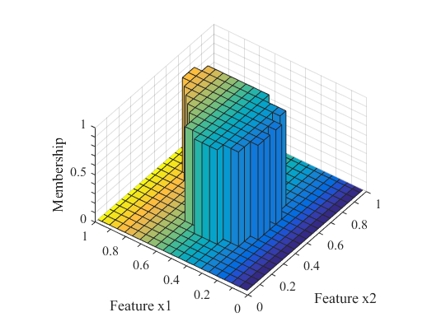
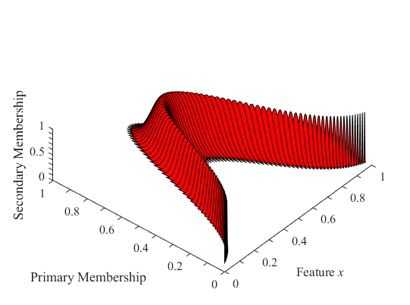
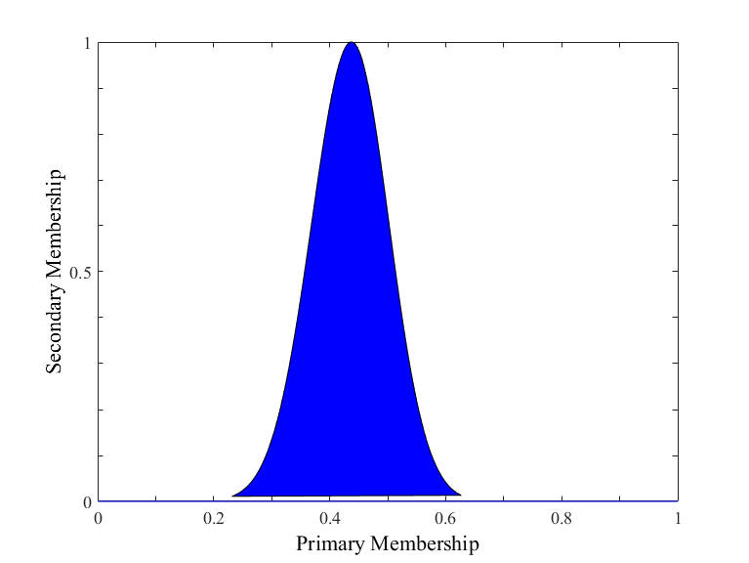
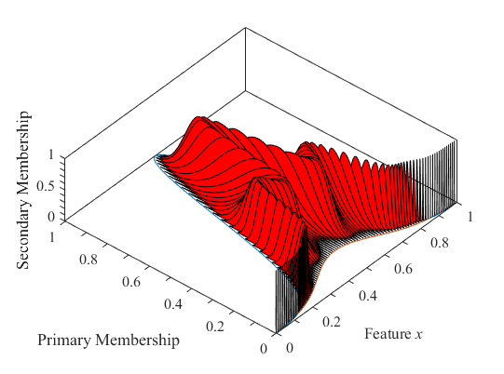
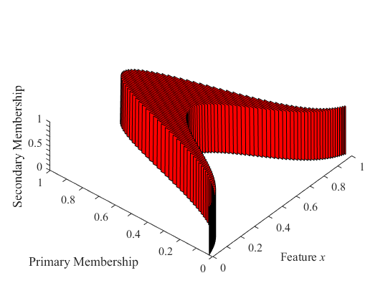
Choices of membership functions
Crisp
General
T2
Data set
T1 fuzzy
Snaky
T2
Interval T2

Slide 9
Actual v/s Desired
A dichotomy of what is desired in membership functions versus what is actually available

Slide 10
Choice of membership function
Application requirements
Available data
Desired Scenario

Slide 11
2.
RESEARCH METHODOLOGY
Let’s see what methods were employed in our research

Slide 12
A method to guess the appropriate MF
A method to prove the correctness
A method to establish directives

Slide 13
The choice of membership function is directed by available data and the application requirements.

Slide 14
3.
PRELIMINARIES
Here we look at some preliminaries which are outlined in our paper

Slide 15
“Snaky” Type-2
A new type-2 membership function between interval T2 and general T2

Slide 16
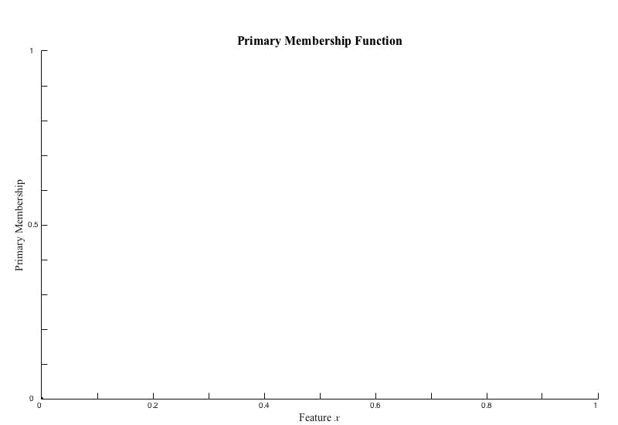
How to obtain a “Snaky” type-2 membership function from a 1-D data

Slide 17
The need for a “snaky” type-2 MF
Interval type-2: Too random for some distributions
Gaussian type-2: Too close to type-1 fuzzy MF
Need an MF to capture both!

Slide 18
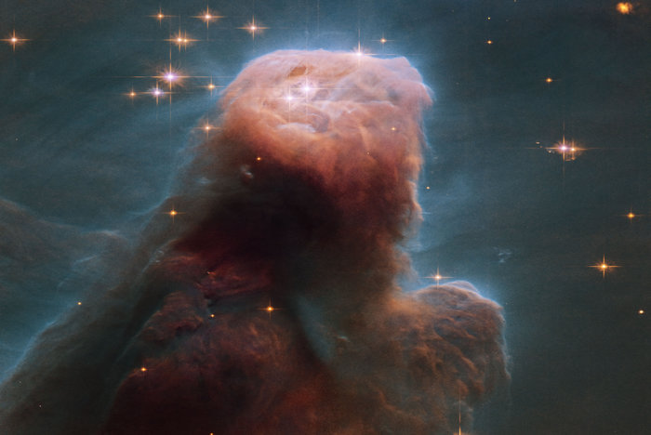
How to visualize data?
Here are some methods of representation.
To guess the appropriate membership function

Slide 19
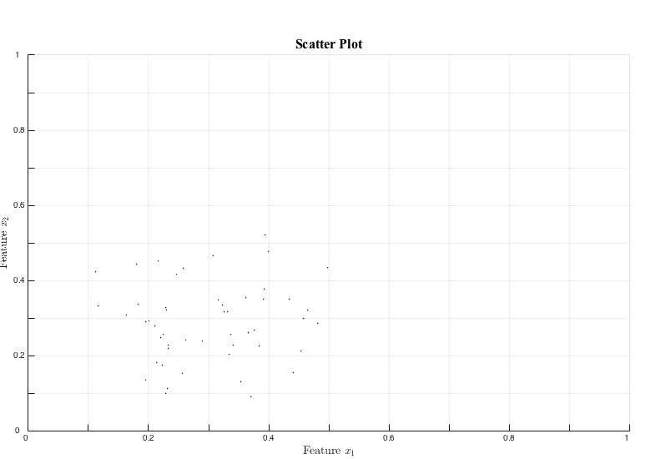
GRAYSCALE ENTROPY

Slide 20
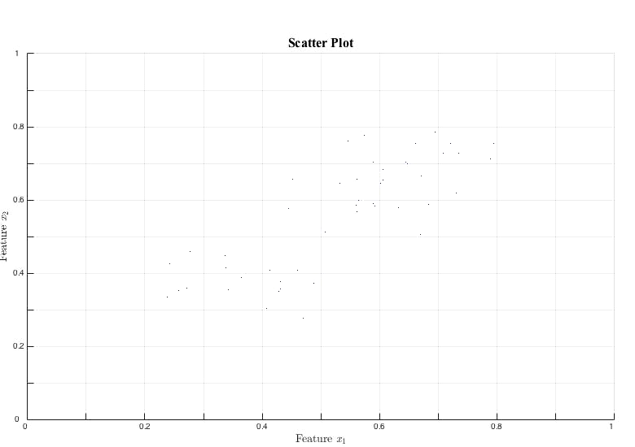
GRAYSCALE ENTROPY

Slide 21
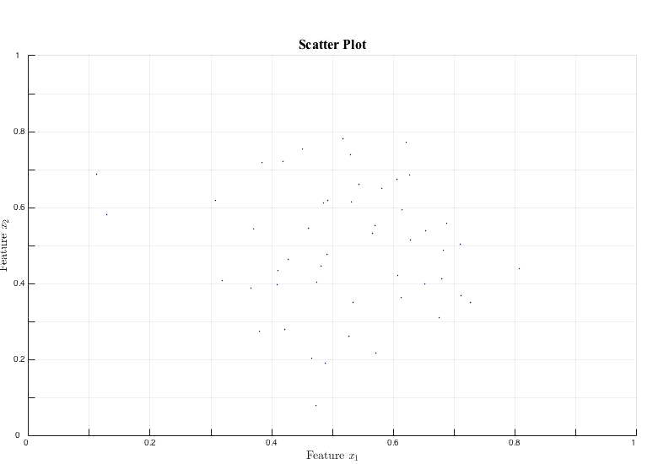
PRIMARY MEMBERSHIP DRILL

Slide 22
4.
PROPOSED ALGORITHM
Let’s look at our proposed iterative algorithm to identify an appropriate MF

Slide 23
Forward stage
Original data to membership function
Reverse stage
Membership function to data set
Similarity analysis
To provide proof of correctness

Slide 24
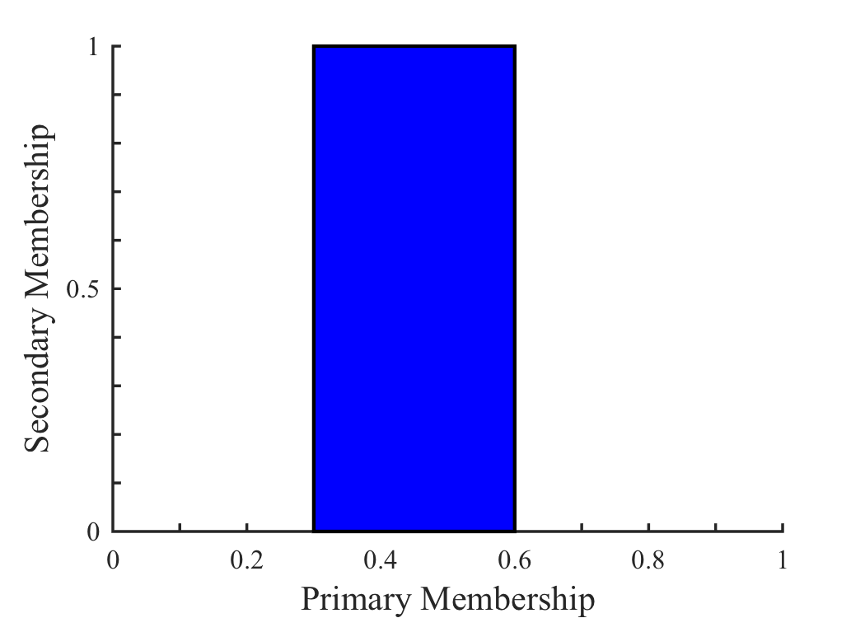
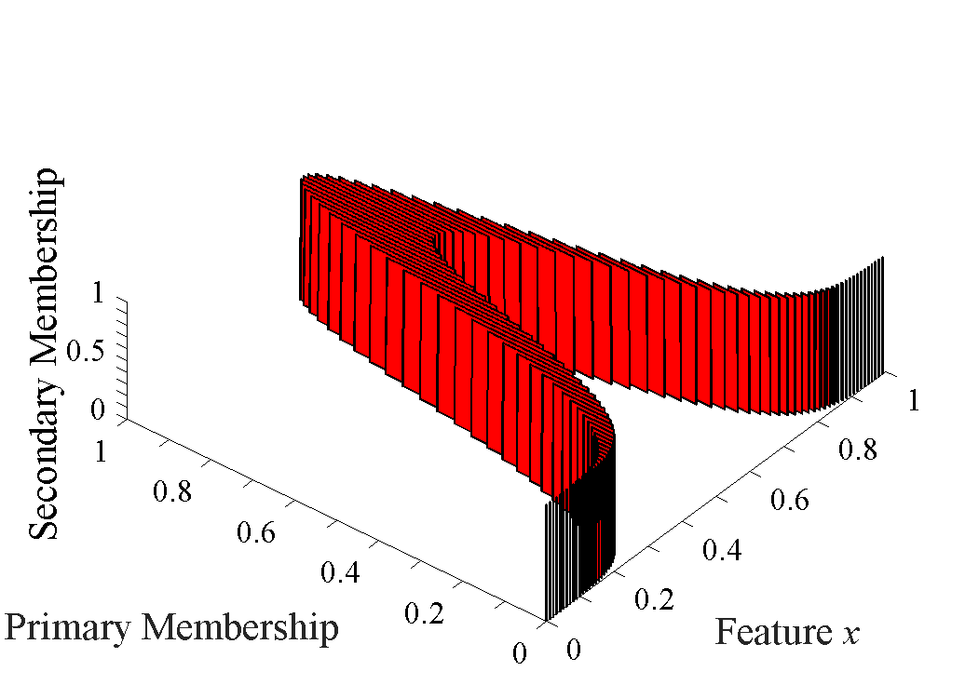
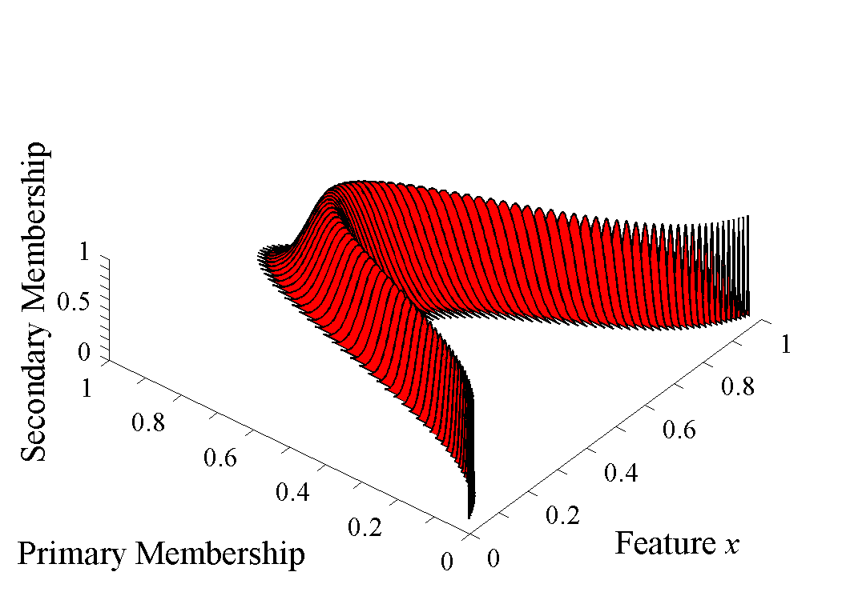
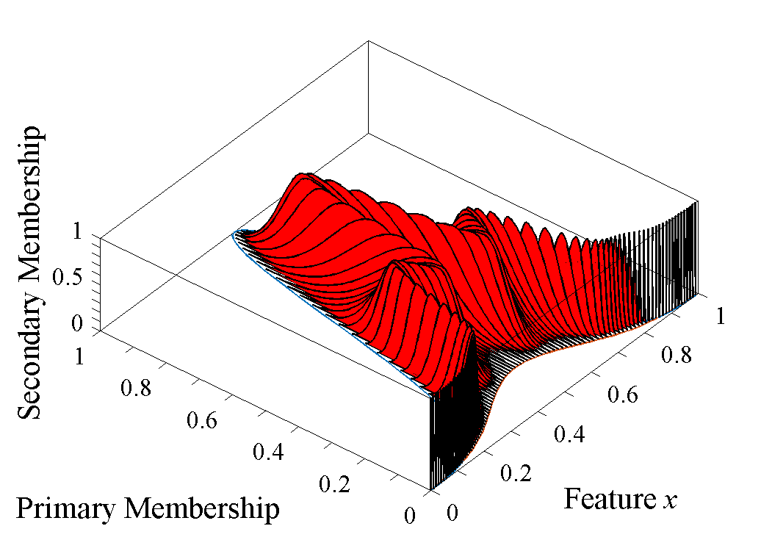
Data Generation i
Data Set C_{i}
Data Generation j
Data Set C_{j}
Crisp MF
Data Generation i
Data Set T1_{i}
Data Generation j
Data Set T1_{j}
T1 FMF
Membership
Function
Generation
Data Generation i
Data Set IT2_{i}
Original Data Set
Original Data Set
RESULT
Data Generation j
Data Set IT2_{j}
IT2 FMF
Data Generation i
Data Set SGT2_{i}
Data Generation j
Data Set SGT2_{j}
SGT2 FMF
Data Generation i
Data Set AGT2_{i}
Data Generation j
Data Set AGT2_{j}
AGT2 FMF

Slide 25
Wilcoxon’s Tests
For similarity analysis of non-parametrized data sets

Slide 26
Signed-rank test
Used when the data is paired
Rank-sum test
Used when the data is not paired

Slide 27
Iris data
479 times
Improved results from Interval type-2 over Type-1*
102 times
Improved results from Gaussian type-2 over Type-1*
Using the iterative algorithm to measure the similarity of various MFs on the Iris data

Slide 28
Why should we analyze similarity?
To regenerate same data from MF
To generate different data distributions
According to requirements of the application

Slide 29
5.
REVIEW
A brief overview of some of the ideas that were discussed

Slide 30
Verify with iterative algorithm
Data sets
Application
Guess using Entropy and PM Drill

Slide 31
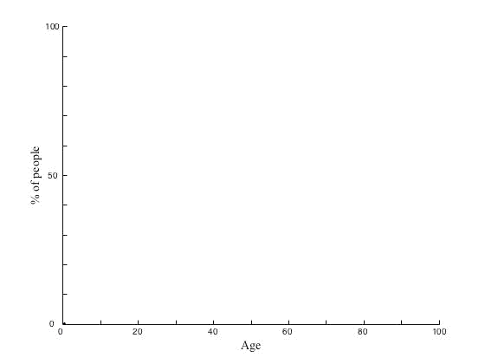
A use case for “snaky” type-2 fuzzy MFs
Age categories
Survey on what can age can be considered ‘young’, ‘middle aged’, or ‘old’.

Slide 32

Thanks!
Any questions?
You can find us at:
Desh Raj - r.desh@iitg.ernet.in
Kenil Tanna – kenil@iitg.ernet.in
Bhuvnesh Garg – g.umang@iitg.ernet.in
Dr. Frank Rhee – frhee@hanyang.ac.kr

